Slide 1
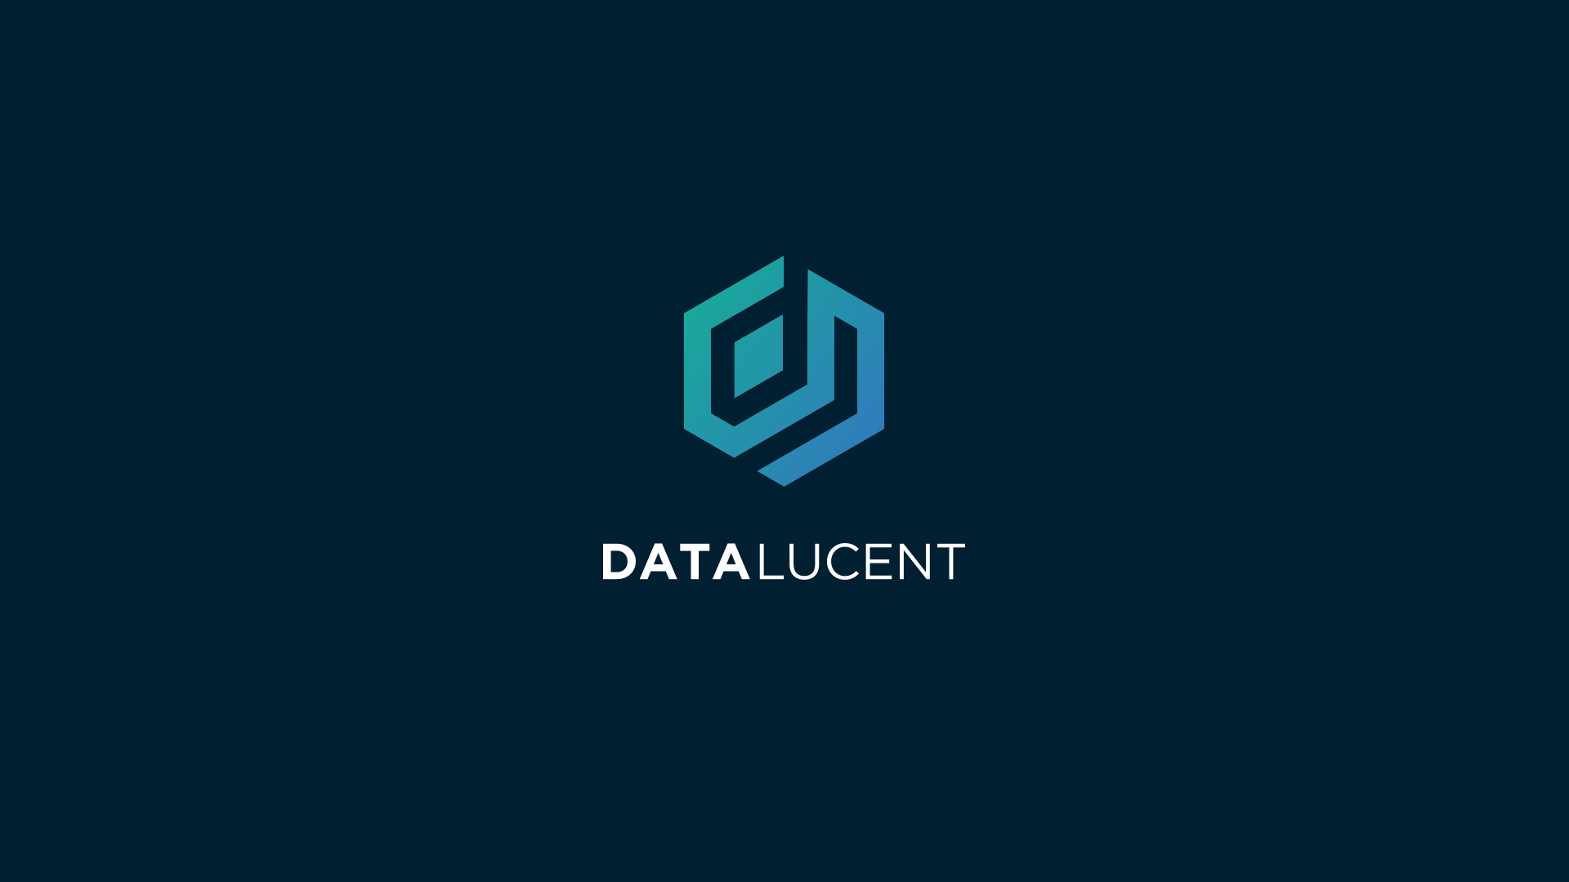

Slide 2
Technology Update
We’ve made improvements!

Slide 3

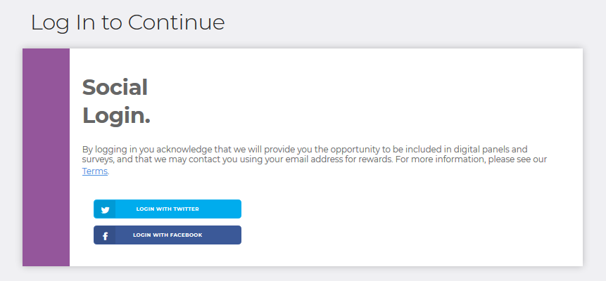
Front End
File Upload Improvements
An improved upload tool that eliminates media from .zip files is under development.
Implemented Referral System
Users can enter codes during file upload that track referrals and provide additional incentive program options.
Enhanced UX/UI
We’re bringing in UX/UI experts
to improve and harden our process.

Slide 4

Back End
DataLucent Create API:
Generates user identification for data tracking from creation to deletion.
Shared infrastructure across all DataLucent applications maintains standardization and activity logging.
DataLucent Delete API:
Remove all information for any user programmatically upon request.
Automatically informs user that their data has been deleted.
File Validation API:
Python implementation to automatically validate a user’s data or flag it for human intervention.

Slide 5

Technology Preview: Automated File Downloads
DataLucent is working with experts to simplify the file acquisition process and reduce friction for our users.
In the near term we expect to have an automated solution for Google and Facebook with other networks soon to follow.

Slide 6
Product Update
Current Work at DataLucent

Slide 7

Near Term Web Strategy
Deploy four versions of the web app as functional models on how our consumer facing data acquisition systems can operate.
Each version of the web app has a unique audience, design, marketing strategy, and incentive structure.
Data is acquired similarly across apps through our patented two-step download/upload process for every audience.

Slide 8
Web App Strategies
Gaming Audience: Focused on influencer marketing and aimed at the gaming segment. Incentives promote community, referrals promote network effects.
Luxury Brands: High-end tailored experience with luxury brands and large incentives. This web app serves as a model for future luxury brand experiences.
Mainstream Brands: This branded experience focuses on volume and is designed to serve as a model for large brands with smaller-sized incentives.
Direct Advertising: An evolved version of current web app, this version is design to harden our online messaging and create a continuous stream of low-cost consumer data.

Slide 9
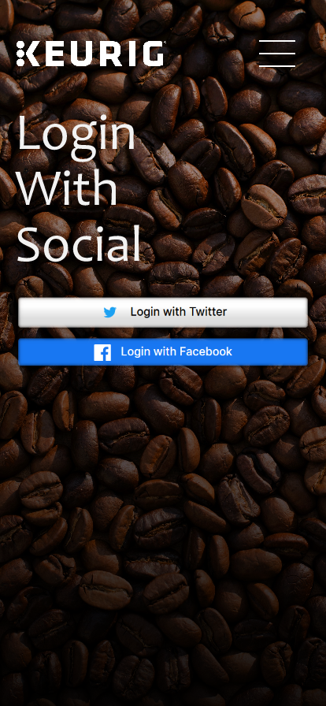

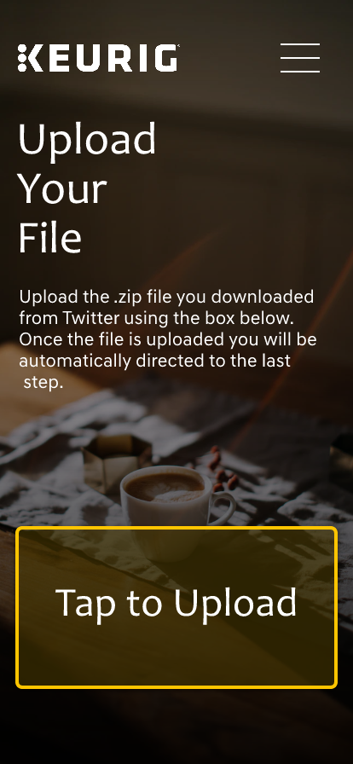
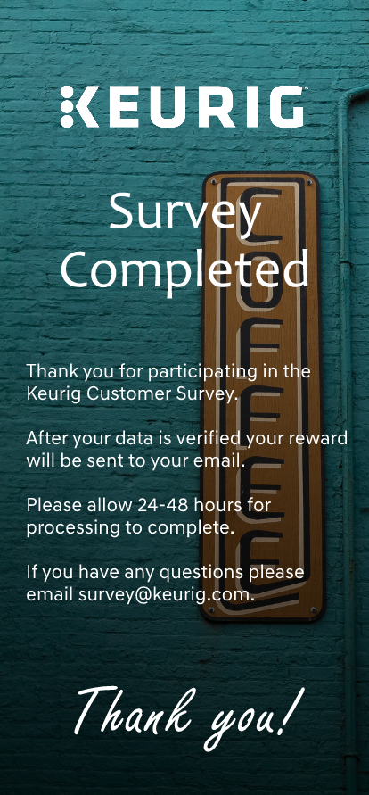
Product Preview: Keurig

Slide 10
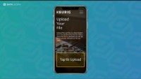
Product Preview: Keurig (Video)

Slide 11
Future Product Strategy
Mobile Application

Slide 12
Product Preview: DataLucent Mobile App
Meet Beth and Chris, your personal guide for data literacy and learning how to earn money from your data.
This app will teach individuals about their data rights, walk them through the data monetization process, and be the central repository for information and tools designed to help bring consumers into the consumer data value chain.

Slide 13
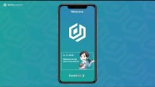
Product Preview: Gamified Mobile App (Video)

